Slide 1
References
Noise Remo al
Filtering
Correlation & Con olution Kernels
Image Boundary
Noise Remo al
Misc.
Computer Vision Image Noise
Mr. Anwar Khan
Image Filtering

Slide 2
References Noise Remo al Filtering
Correlation & Con olution Kernels
Image Boundary
Noise Remo al
Misc.
Outline
1 References
2
Noise Removal Noise in an image Types of Noise
Image Filtering

Slide 3
References Noise Remo al Filtering
Correlation & Con olution
Kernels
Image Boundary
Noise Remo al
Misc.
Reference Books
Reference books for this lecture:
Chapter 4: Computer Vision: Algorithms and Applications, Richard Szeliski, Springer, latest edition.
4 / 68

Slide 4
References Noise Remo al Filtering
Correlation & Con olution
Kernels
Image Boundary
Noise Remo al
Misc.
Reference Books
Reference books for this lecture:
Chapter 4: Computer Vision: Algorithms and Applications, Richard Szeliski, Springer, latest edition.
Chapter 3: Digital Image Processing, Gonzalez & Woods, Prentice Hall latest edition.
4 / 68

Slide 5
References Noise Remo al Filtering Correlation & Con olution Kernels Image Boundary Noise Remo al Misc.
Noise in an image
What is noise?
Noise could arise due to:
Light variations Camera electronics Surface reflectance Lens aberrations

Slide 6
References Noise Remo al Filtering Correlation & Con olution Kernels Image Boundary Noise Remo al Misc.
Noise in an image
What is noise?
In practical systems we encounter noise in images. Noise is also a function and it gets combined with the original function. Thus, digitized image can be written as:
I′(x, y) = I(x, y) + η(x, y) (1)
where I′ is recorded image, I is noise free image and η is noise function.
7 / 68

Slide 7
References Noise Remo al Filtering Correlation & Con olution Kernels Image Boundary Noise Remo al Misc.
Noise in an image
What is noise?
In practical systems we encounter noise in images. Noise is also a function and it gets combined with the original function. Thus, digitized image can be written as:
I′(x, y) = I(x, y) + η(x, y) (1)
where I′ is recorded image, I is noise free image and η is noise function.
What noise function looks like? There are different types of noise.
Salt and Pepper noise Impulse noise Gaussian noise
7 / 68

Slide 8
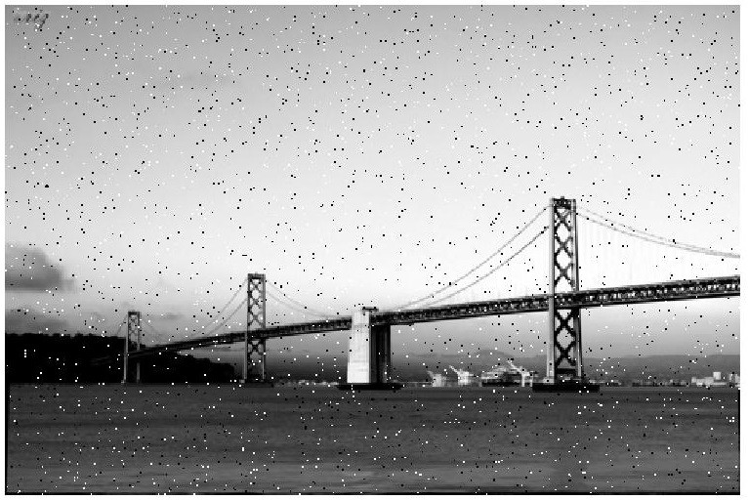
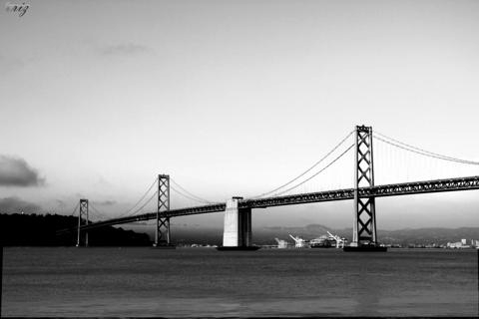
References Noise Remo al Filtering Correlation & Con olution Kernels Image Boundary Noise Remo al Misc.
Types of Noise
Salt & Pepper Noise
- Salt & Pepper Noise: Random occurrence of black and white pixels.
Matlab Function
J = imnoise(img1,’salt & pepper’,0.02);
Original Image
8 / 68

Slide 9
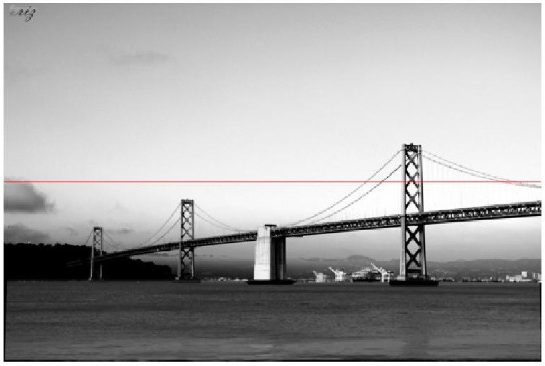
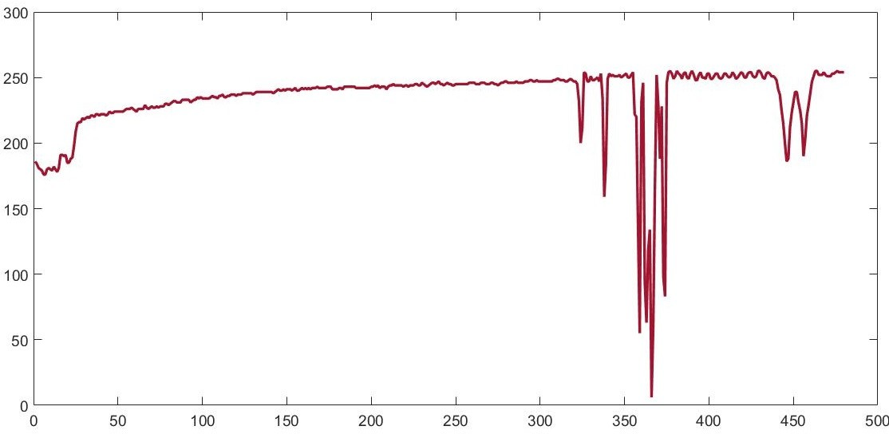
References Noise Remo al Filtering Correlation & Con olution Kernels Image Boundary Noise Remo al Misc.
Types of Noise
Salt & Pepper Noise
- Salt & Pepper Noise: Random occurrence of black and white pixels.
8 / 68

Slide 10
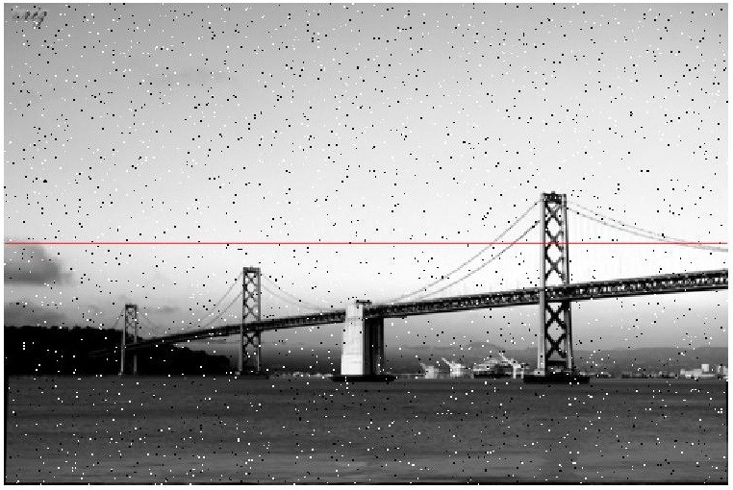
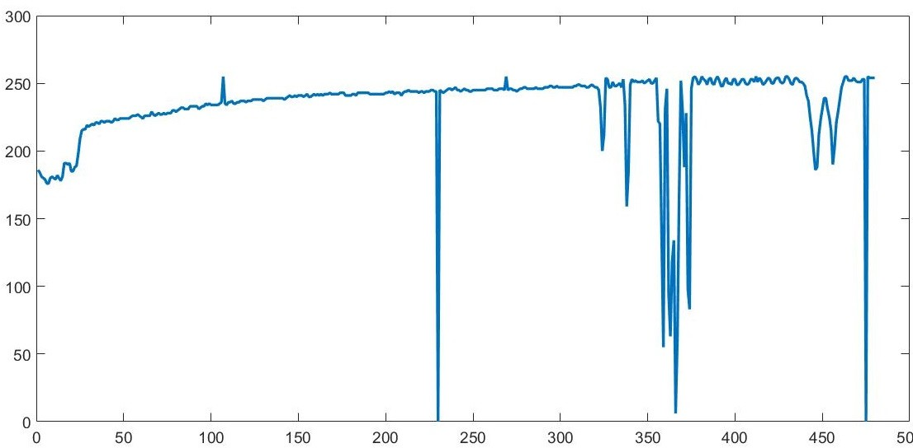
References Noise Remo al Filtering Correlation & Con olution Kernels Image Boundary Noise Remo al Misc.
Types of Noise
Salt & Pepper Noise
- Salt & Pepper Noise: Random occurrence of black and white pixels.
8 / 68

Slide 11
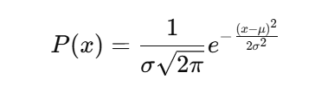
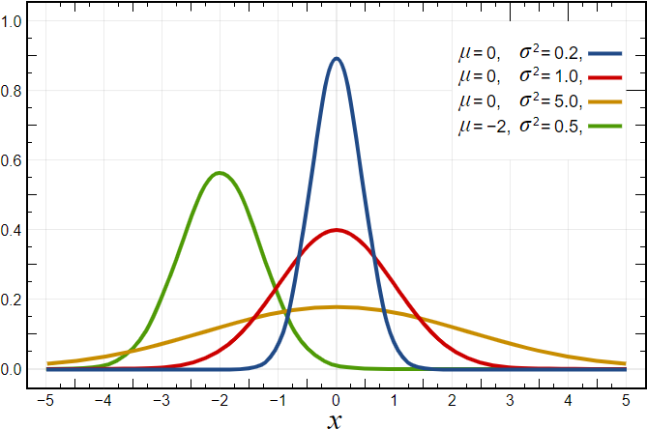
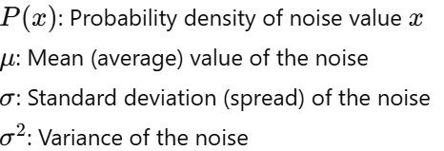
References Noise Remo al Filtering Correlation & Con olution Kernels Image Boundary Noise Remo al Misc.
Types of Noise
Gaussian Noise
- Gaussian Noise: Noise having a probability density function (PDF) equal to that of the normal distribution, which is also known as the Gaussian distribution.
where µ = mean gray value and σ² = standard deviation

Slide 12
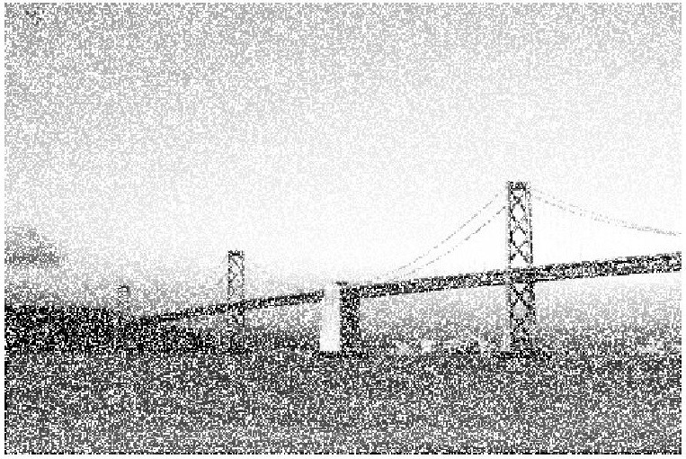
References Noise Remo al Filtering Correlation & Con olution Kernels Image Boundary Noise Remo al Misc.
Types of Noise
Gaussian Noise
- Gaussian Noise: having a probability density function (PDF) equal to that of the normal distribution.
Original Image
Noisy image
13 / 68

Slide 13
References Noise Remo al Filtering Correlation & Con olution Kernels Image Boundary Noise Remo al Misc.
Types of Noise
Gaussian Noise
- Gaussian Noise: having a probability density function (PDF) equal to that of the normal distribution.
13 / 68

Slide 14
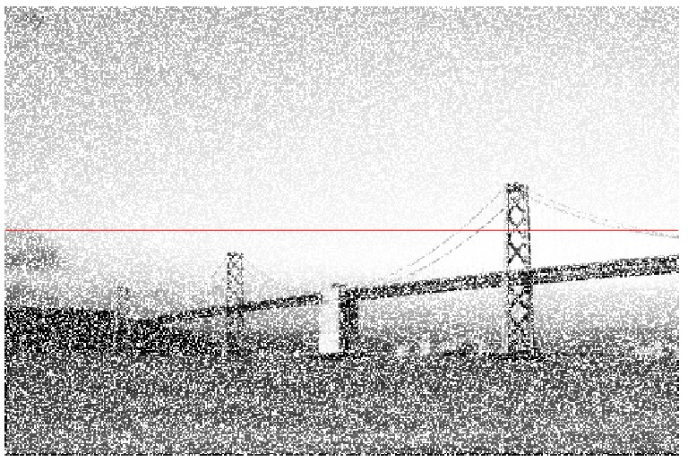
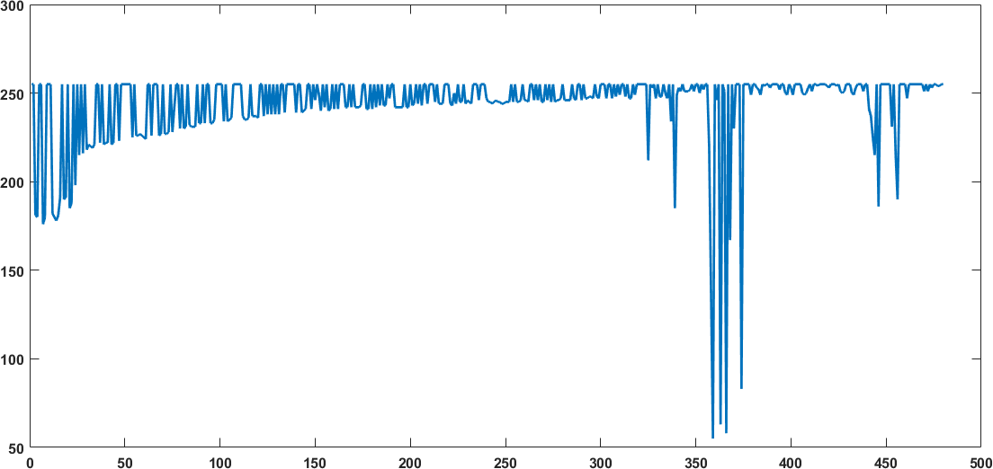
References Noise Remo al Filtering Correlation & Con olution Kernels Image Boundary Noise Remo al Misc.
Types of Noise
Gaussian Noise
- Gaussian Noise: having a probability density function (PDF) equal to that of the normal distribution.
13 / 68

Slide 15
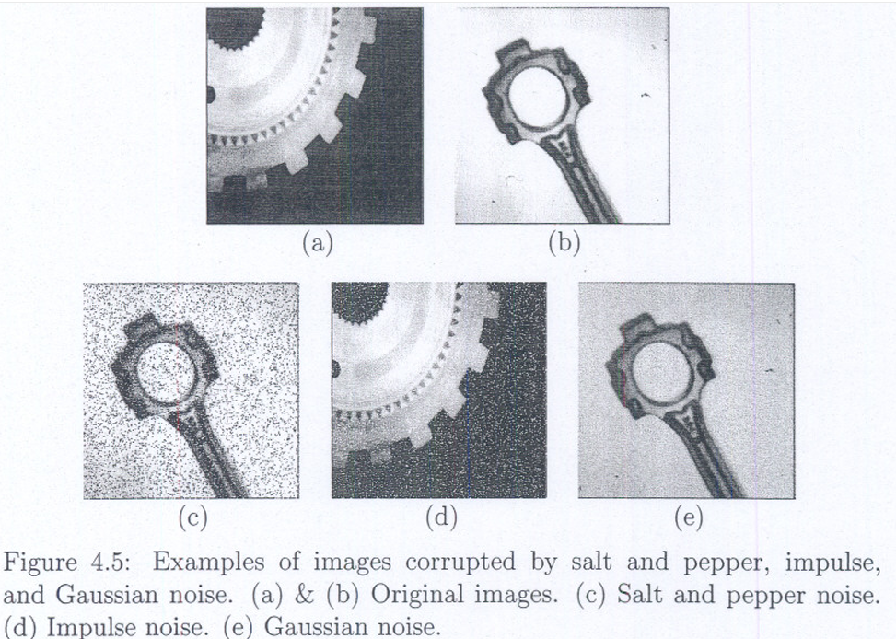
Some common types of noise are salt and pepper noise, impulse noise, and Gaussian noise. Salt and pepper noise contains random occurrences of both black and white intensity values. However, impulse noise contains only random occurrences of white intensity values. Unlike these, Gaussian noise contains variations in intensity that are drawn from a Gaussian or normal distribution and is a very good model for many kinds of sensor noise, such as the noise due to camera electronics (see Figure 4.5)

Slide 16
References Noise Remo al Filtering Correlation & Con olution Kernels Image Boundary Noise Remo al Misc.
Types of Noise
Noise
How to remove noise?
14 / 68

Slide 17
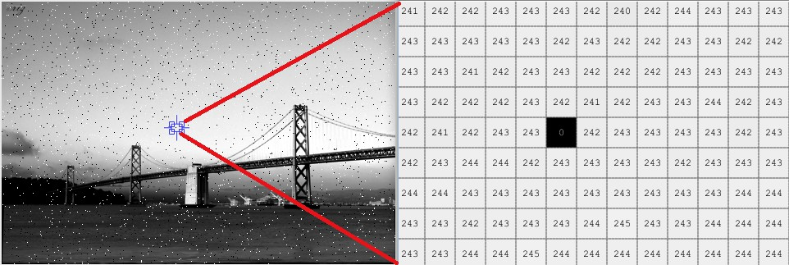
References Noise Remo al Filtering Correlation & Con olution Kernels Image Boundary Noise Remo al Misc.
Types of Noise
Noise
How to remove noise?
Any idea now?
14 / 68

Slide 18
References Noise Remo al Filtering Correlation & Con olution Kernels Image Boundary Noise Remo al Misc.
Types of Noise
Noise
How to remove noise?
How about replacing pixels value with average of its neighboring pixels?
14 / 68

